Slide 1

Mask Detection Using Convolutional Neural Networks
Professor: Dr. Zarrinbal Masouleh
Student: Pedram Peiro - 9825006
Jan 2023
Amirkabir University of Technology
(Tehran Polytechnic)

Slide 2

Contents
Problem Statement
Libraries
Image Identification
Transfer Learning
Splitting Dataset into Train/Dev/Test Sets
1
3
5
7
9
2
4
6
8
Introduction
DataViz
Image Preprocessing
Basic CNN Models

Slide 3
Problem Statement
Objective
Application
Medical pieces of advice
Detect whether a person is wearing a mask or not
Estimate the pace of spread
Be readier
Example

Slide 4

Introduction to CNN
شکل­گیری گروه
روحیه

Slide 5
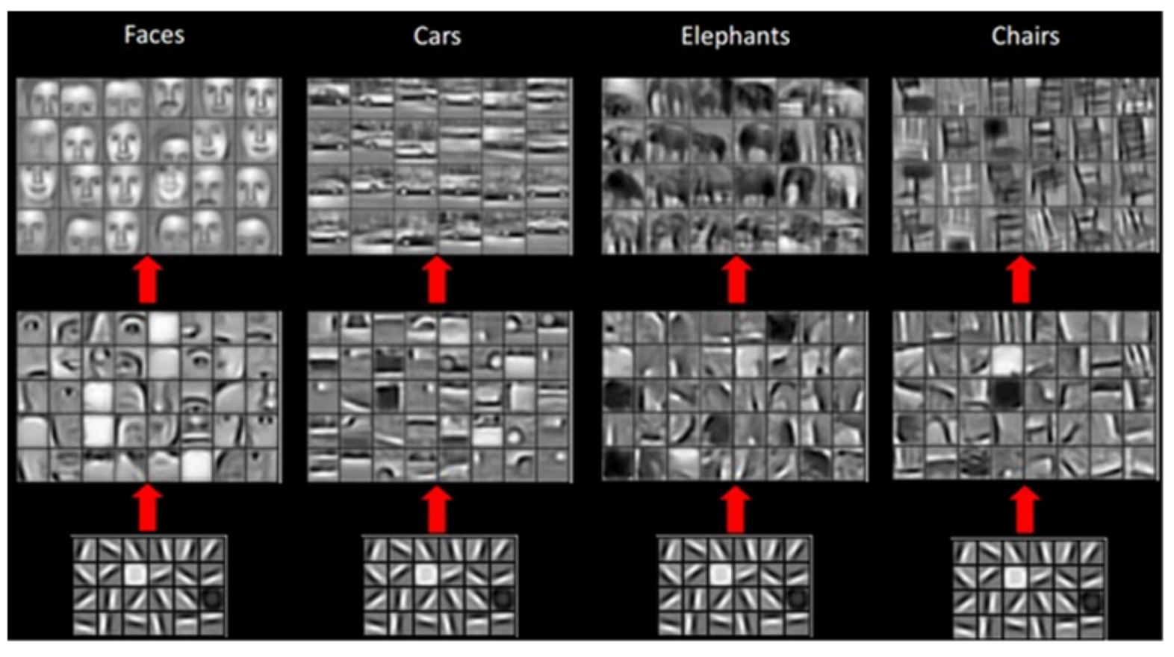
Introduction to CNN
شکل­گیری گروه
روحیه

Slide 6









Libraries

Slide 7
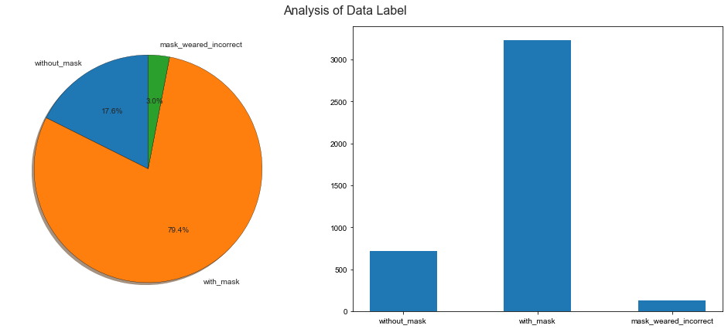
DataViz

Slide 8
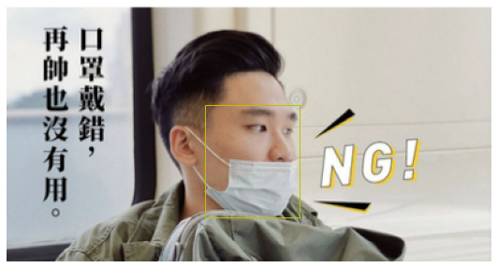

Images Identification with Data Labels
Original Image
What we want
Red: without_mask
Green: with_mask
Yellow: mask_weared_incorrect

Slide 9
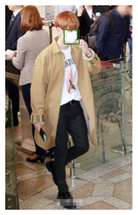
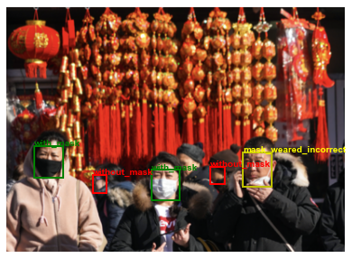
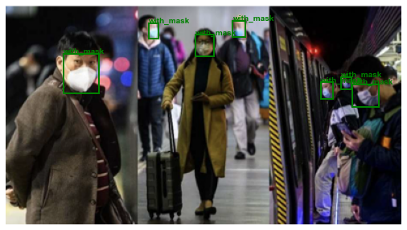
Images Identification with Data Labels
HOW TO ACHIEVE THIS?
XML files provided in “annotations”

Slide 10
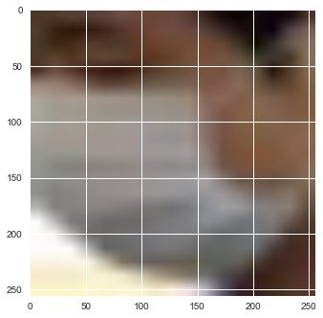
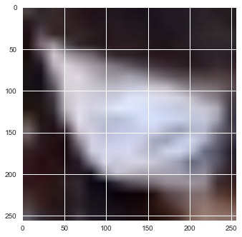
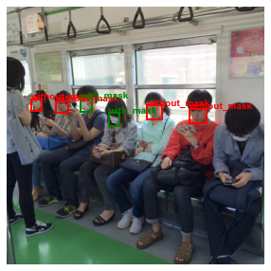
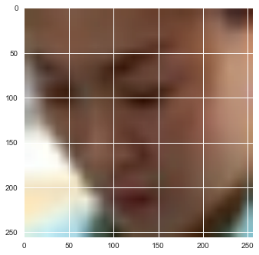
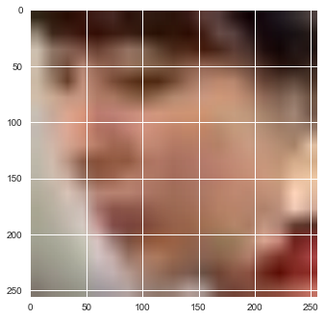
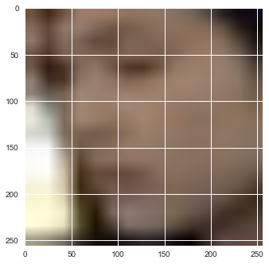
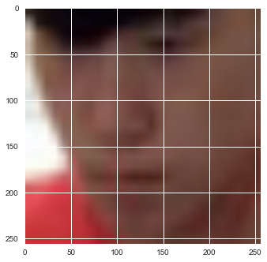
Image Preprocessing
4072 images of all classes
3949 images of wear/not wear classes
Train Set: 3159
Dev Set: 395
Test Set: 394
روحیه

Slide 11
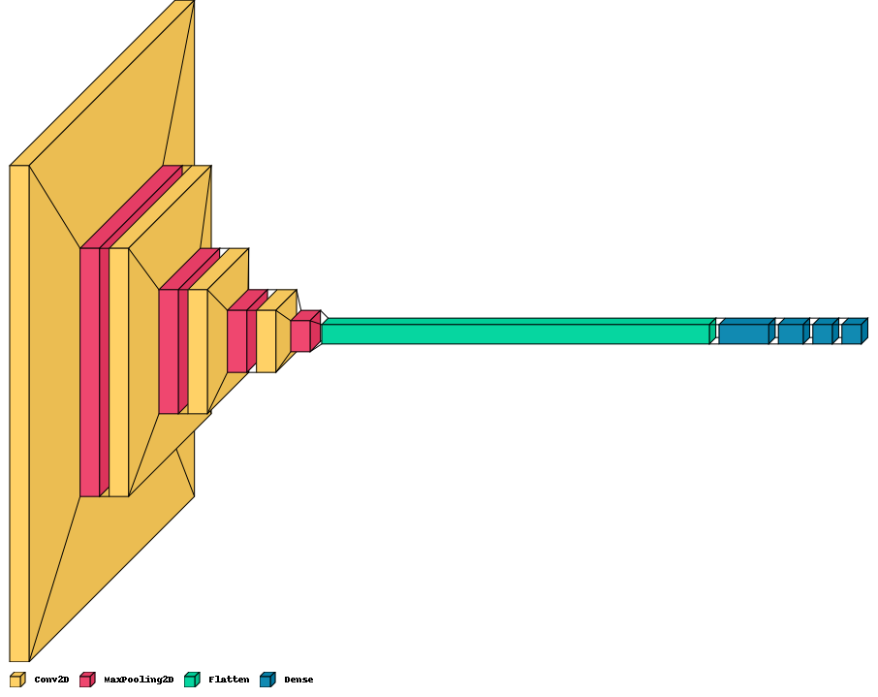
Basic CNN Models, Pt. 1
Conv layer
6 filters, filter size=5
Padding = same
MaxPool Layer
pool size=2 , stride=2
Padding = same
Conv layer
16 filters, filter size=5
Padding = same
MaxPool Layer
pool size=2 , stride=2
Padding = same
Conv layer
32 filters, filter size=5
Padding = same
MaxPool Layer
pool size=2 , stride=2
Padding = same
Input layer
Conv layer
64 filters, filter size=5
Padding = same
MaxPool Layer
pool size=2 , stride=2
Padding = same
FC Layer
Nodes = 512
FC Layer
Nodes = 256
FC Layer
Nodes = 128
Output layer
Activation = sigmoid
Flatten

Slide 12
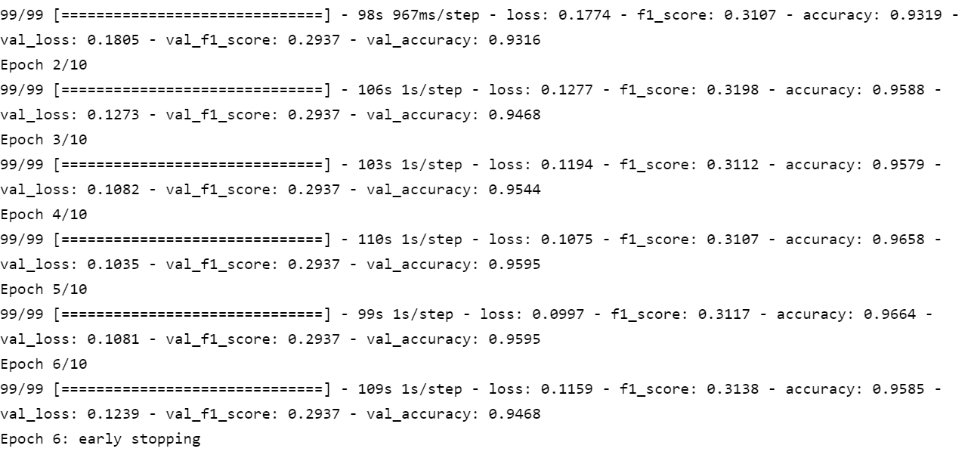
Basic CNN Models, Pt. 1
# Parameters:
8,620,441
Optimizer:
Adam
Loss Function:
Binary Cross Entropy
Type | Error
Human-level performance | 0.00%
Train set | 3%
Dev set | 4%
Test set | 2%
Bias

Slide 13
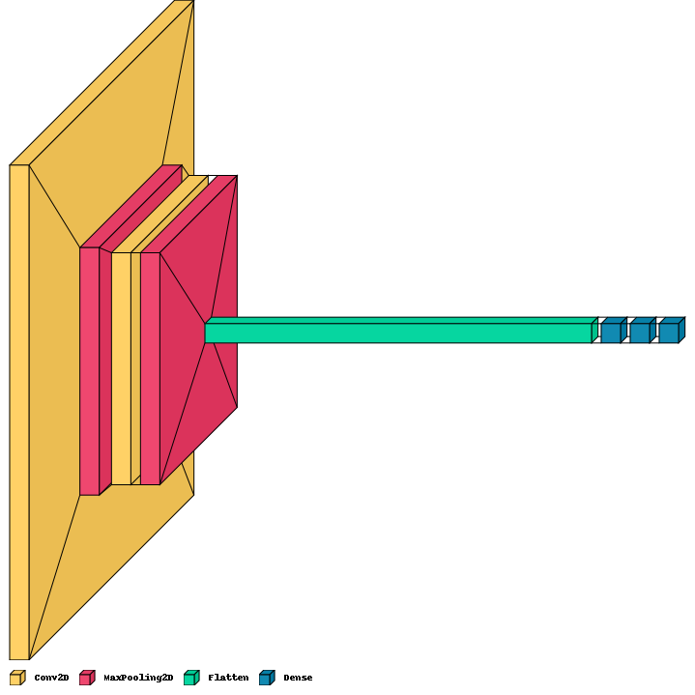
Basic CNN Models, Pt. 2
Conv layer
6 filters, filter size=5
Padding = same
MaxPool Layer
pool size=3 , stride=2
Padding = same
Conv layer
10 filters, filter size=5
Padding = same
MaxPool Layer
pool size=3 , stride=1
Padding = same
Input layer
Flatten
FC Layer
Nodes = 128
FC Layer
Nodes = 64
Output layer
Activation = sigmoid

Slide 14
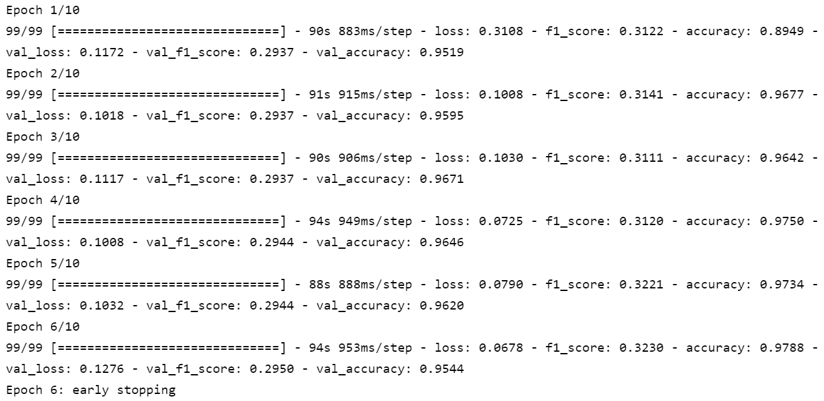
Basic CNN Models, Pt. 2
# Parameters:
19,691,695
Optimizer:
Adam
Loss Function:
Binary Cross Entropy
Type | Error
Human-level performance | 0.00%
Train set | 2%
Dev set | 4%
Test set | 3%
Bias

Slide 15
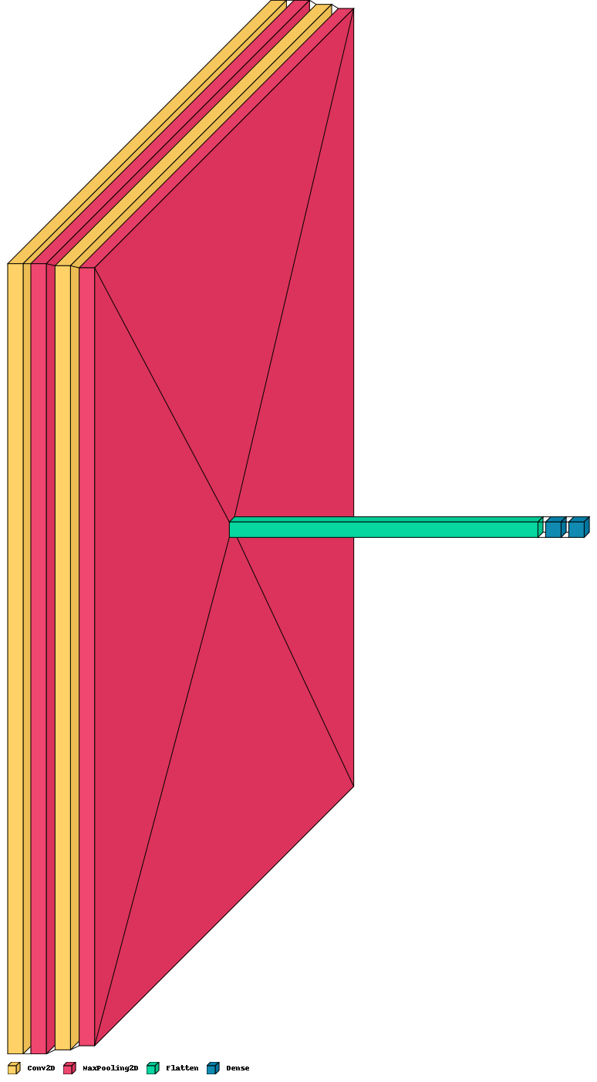
Basic CNN Models, Pt. 3
Conv layer
32 filters, filter size=3
Padding = same
MaxPool Layer
pool size=3 , stride=1
Padding = same
Conv layer
64 filters, filter size=3
Padding = valid
MaxPool Layer
pool size=3 , stride=1
Padding = valid
Input layer
Flatten
FC Layer
Nodes = 128
Output layer
Activation = sigmoid

Slide 16
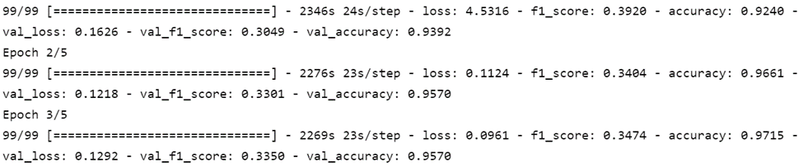
Basic CNN Models, Pt. 3
# Parameters:
520,244,417
Optimizer:
Adam
Loss Function:
Binary Cross Entropy
Type | Error
Human-level performance | 0.00%
Train set | 3%
Dev set | 4%
Test set | 4%
Bias

Slide 17
Transfer Learning
MobileNet – V2
VGG – 19
ResNet – 50
Inception – V3

Slide 18
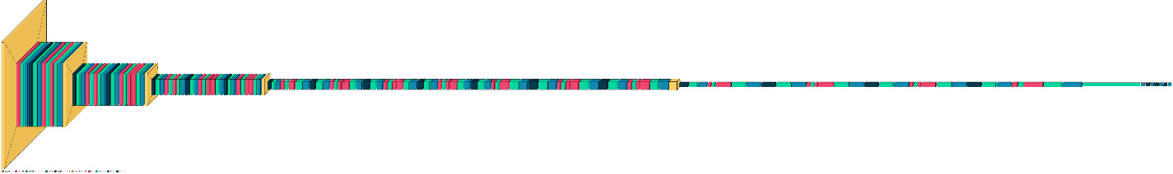
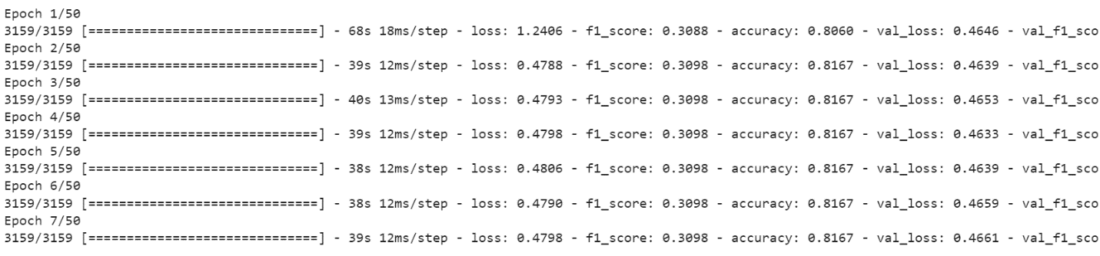
MobileNet – V2
FC Layer
Nodes = 256
Dropout Layer
p = 0.4
FC Layer
Nodes = 128
Dropout Layer
p = 0.3
FC Layer
Nodes = 64
Dropout Layer
p = 0.1
Output layer
Activation = sigmoid
Head Model
Flatten
# Total Parameters: 18,355,777 , # Trainable Parameters: 16,097,793 , Optimizer: Adam, Loss Function: Binary Cross Entropy

Slide 19
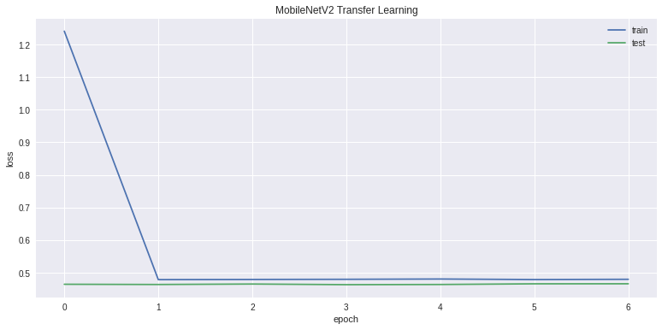
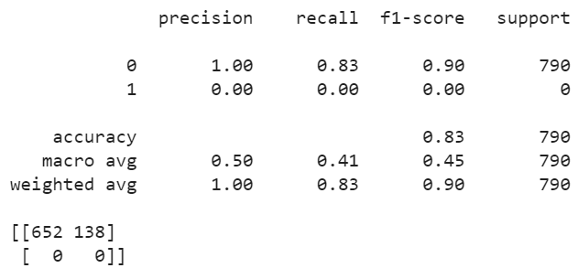
MobileNet – V2

Slide 20
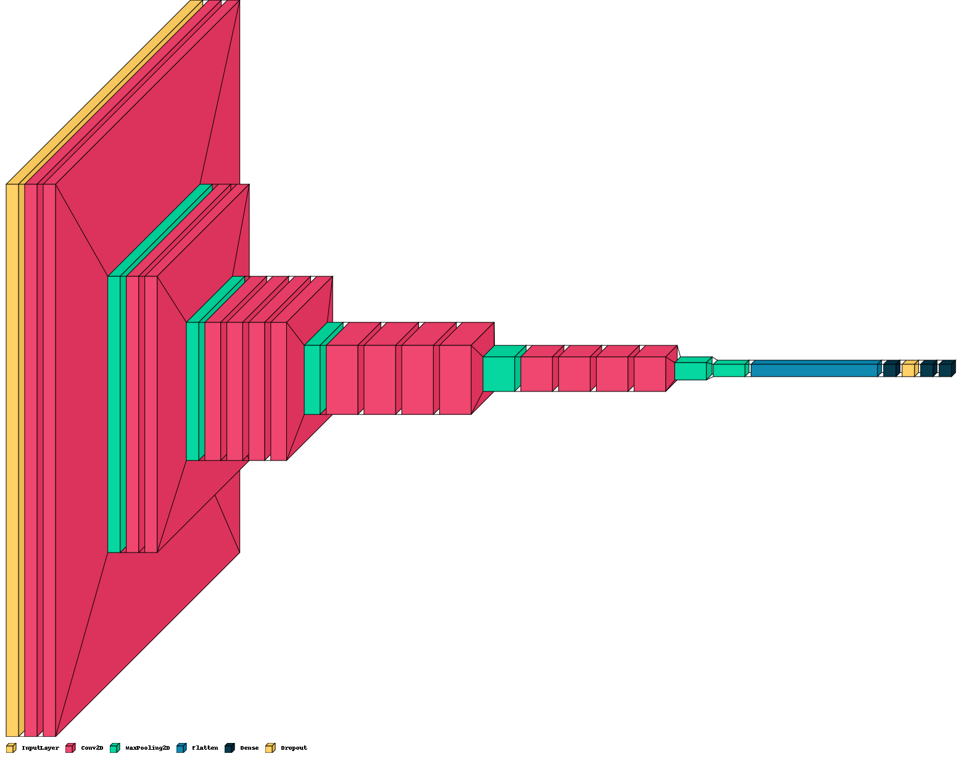
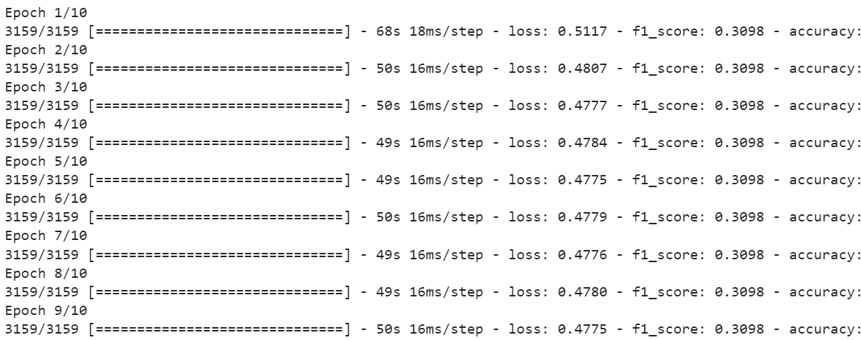
VGG-19
MaxPool Layer
Pool size=3
FC Layer
Nodes = 128
Dropout Layer
p = 0.1
FC Layer
Nodes = 64
Output layer
Activation = sigmoid
Head Model
Flatten
# Total Parameters: 20,294,977 , # Trainable Parameters: 270,593 , Optimizer: Adam, Loss Function: Binary Cross Entropy

Slide 21
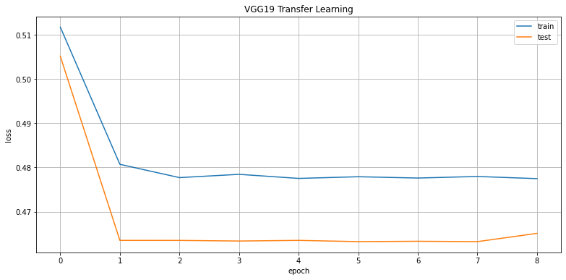
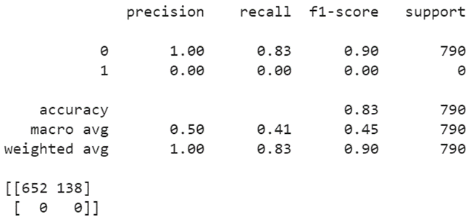
VGG-19

Slide 22

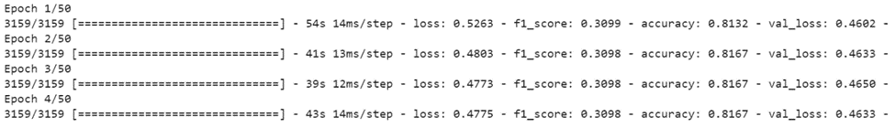
ResNet - 50
MaxPool Layer
Pool size=3
FC Layer
Nodes = 128
Dropout Layer
p = 0.1
FC Layer
Nodes = 64
Output layer
Activation = sigmoid
Head Model
Flatten
# Total Parameters: 24,644,737 , # Trainable Parameters: 1,057,025 , Optimizer: Adam, Loss Function: Binary Cross Entropy

Slide 23
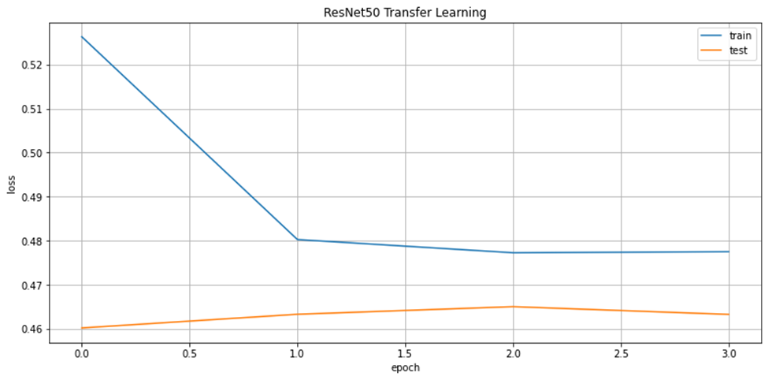

ResNet - 50

Slide 24
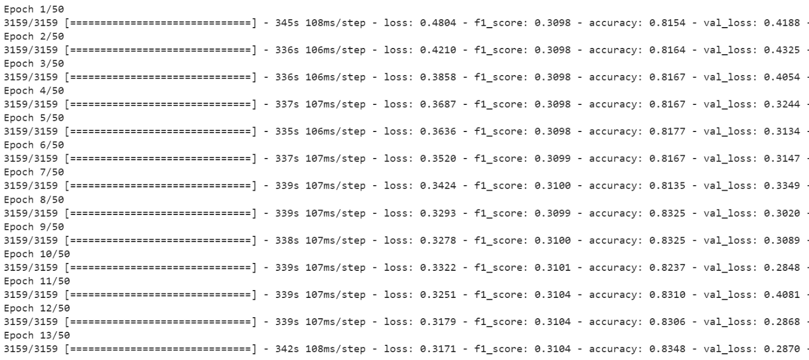
Inception – V3
MaxPool Layer
Pool size=3
FC Layer
Nodes = 128
Dropout Layer
p = 0.1
FC Layer
Nodes = 64
Output layer
Activation = sigmoid
Head Model
Flatten
# Total Parameters: 22,073,377 , # Trainable Parameters: 270,593 , Optimizer: Adam, Loss Function: Binary Cross Entropy

Slide 25
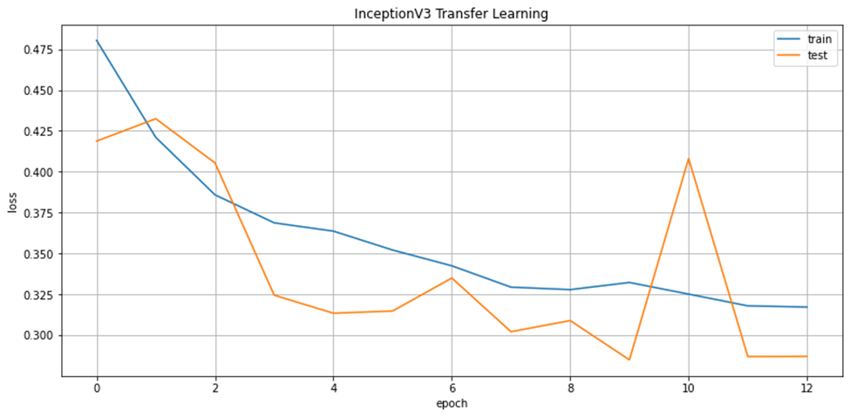
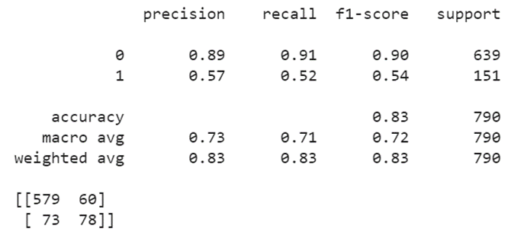
Inception – V3

Slide 26
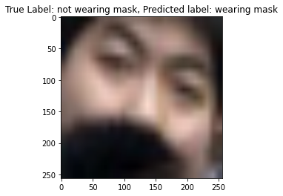
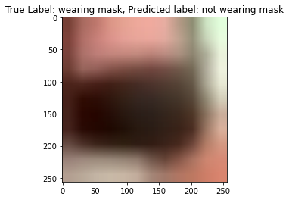
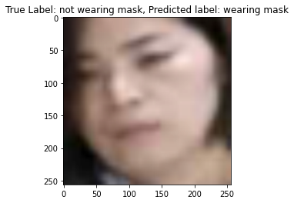
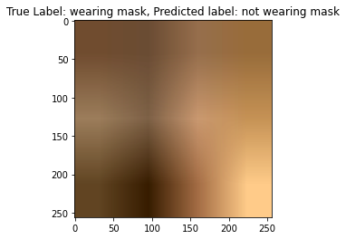
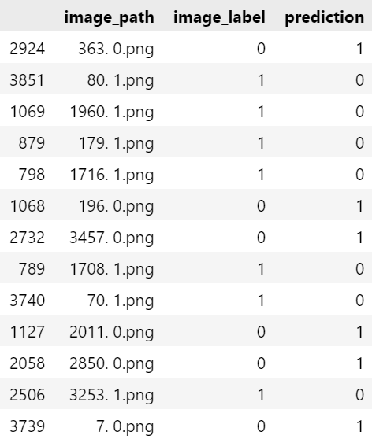
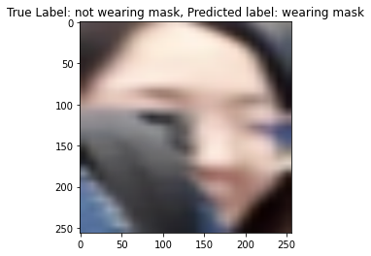
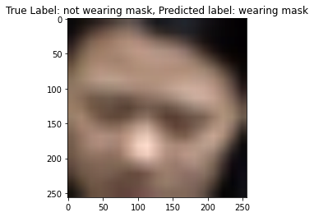
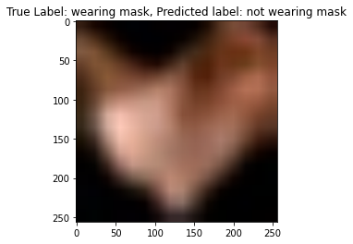
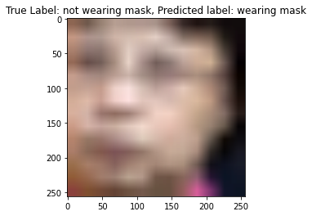
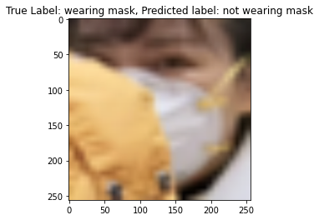
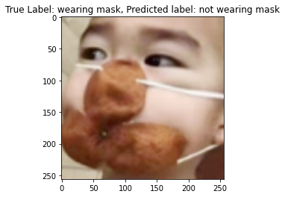
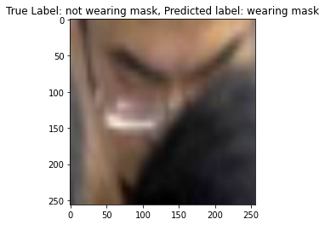
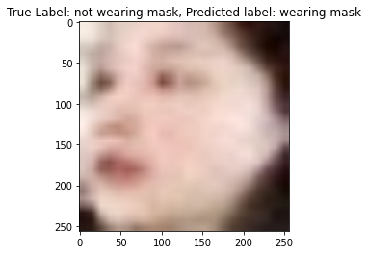
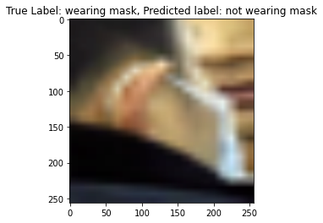
Misclassified Images
شکل­گیری گروه
روحیه

Slide 27
Thanks
Any Questions?

